Slide 1
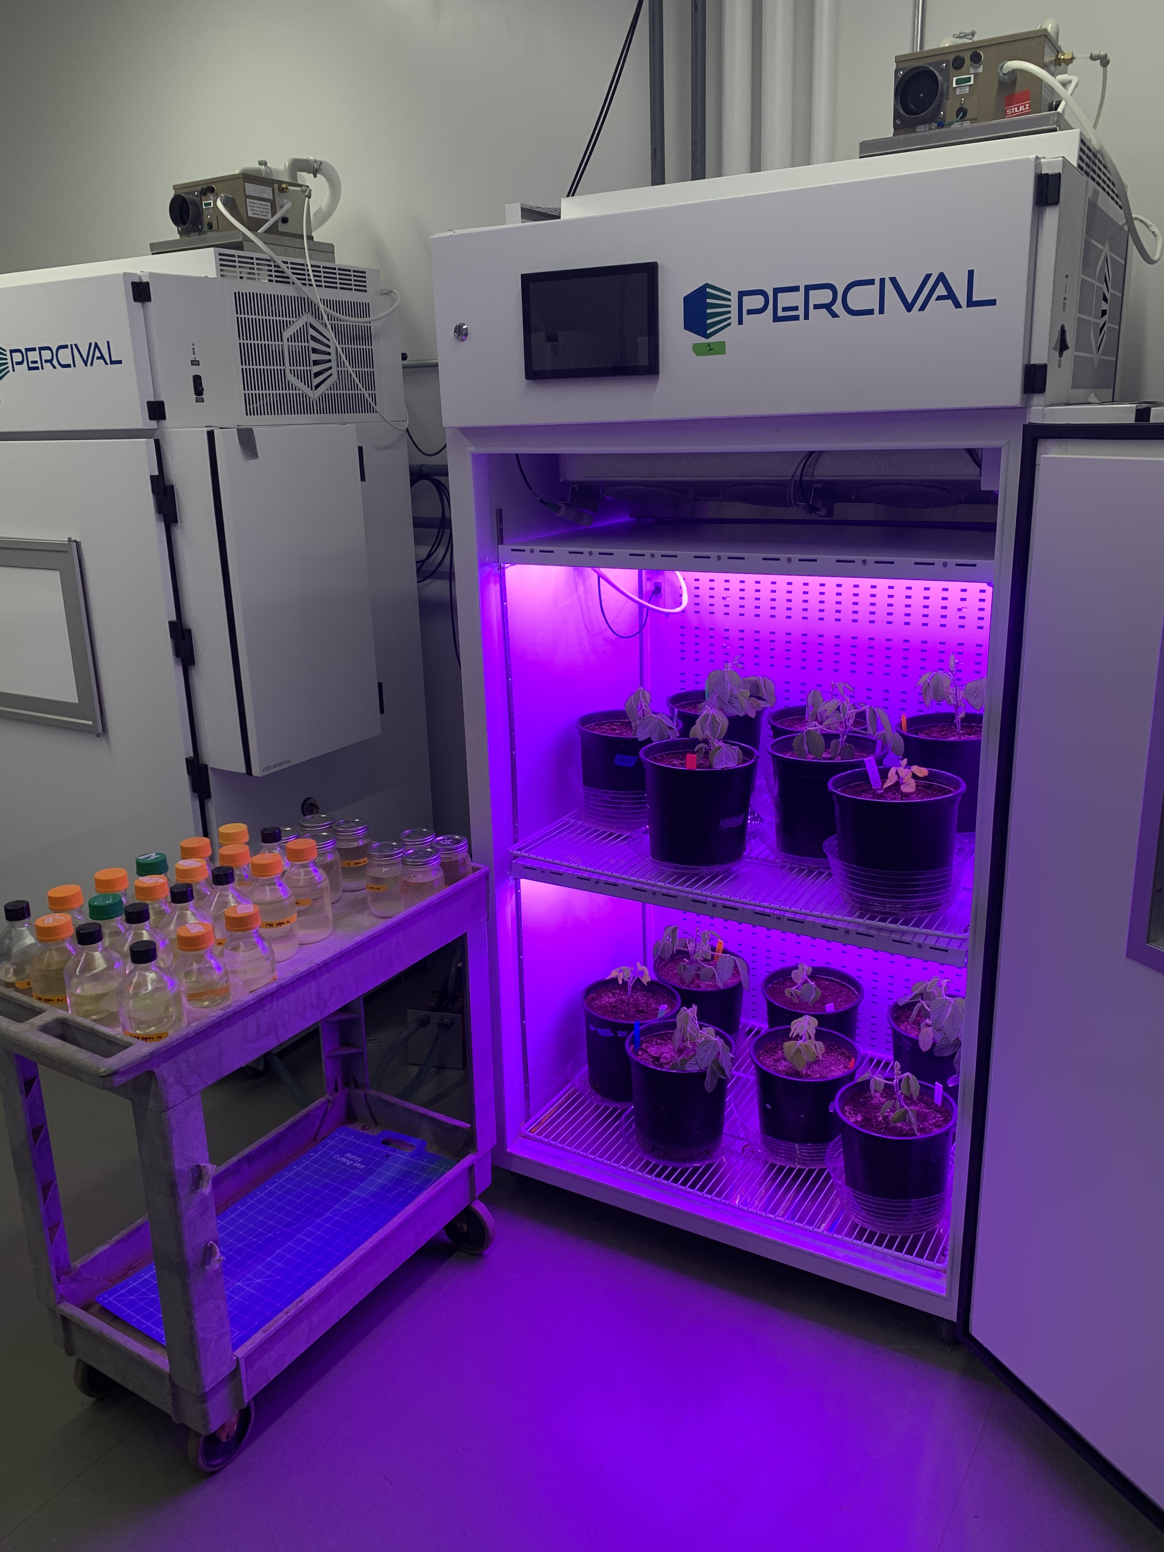
Acquisition strategy
Soil N treatments
0 ppm N
+ BNF
35 ppm N
- BNF
70 ppm N
105 ppm N
CO₂ treatments
140 ppm N
210 ppm N
280 ppm N
400 ppm CO₂
350 ppm N
1000 ppm CO₂
630 ppm N

Slide 2
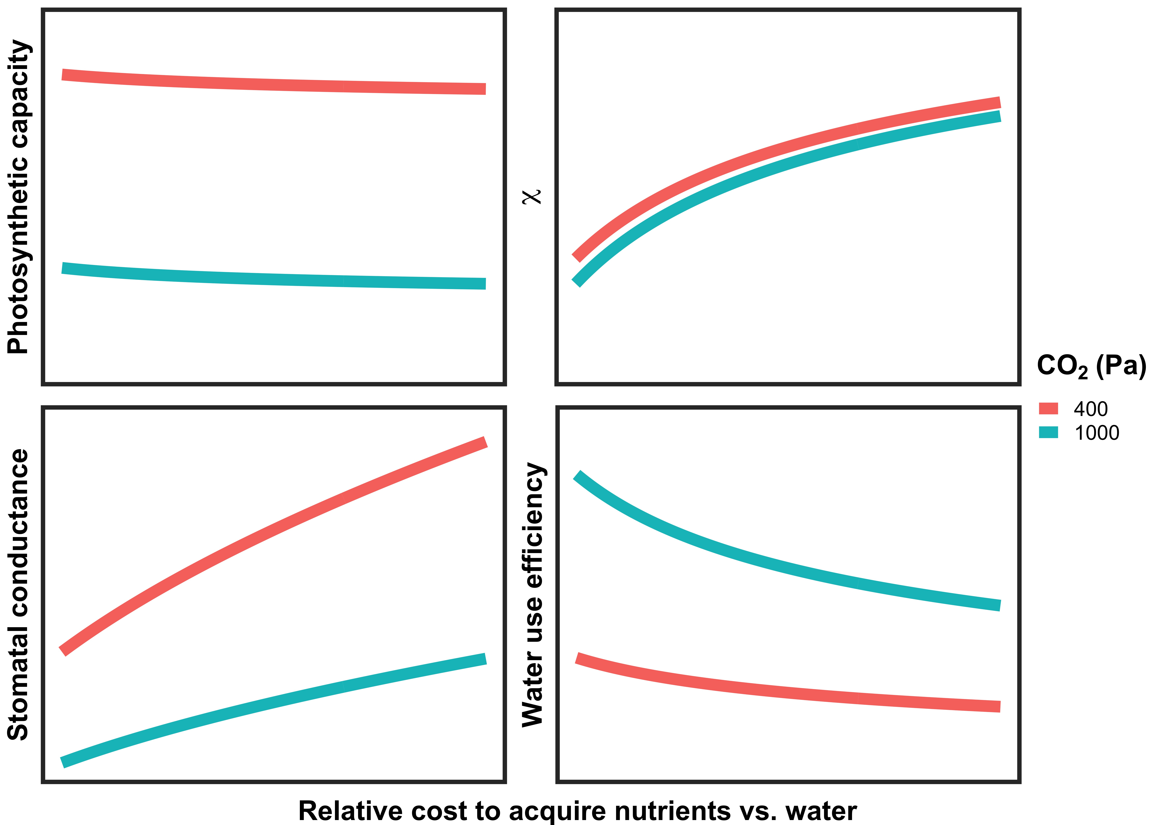
Placeholder for experiment figs

